Slide 1
UniGuide: An AI-Powered Virtual University Assistant for Instant Information Access
Prepared by,
D. Sanjay (20N81A6648)
A. Sunith chand (20N81A6626)
G. Venkatesh (20N81A6629)

Slide 2
ABSTRACT
UNIGUIDE is an AI-powered chatbot created to improve communication and support within educational institutions.
It functions as a human-like interactive assistant and is accessible via a web browser.
UNIGUIDE aims to provide innovative and efficient ways for students and faculty to receive assistance on various topics such as admissions, registration, and campus resources.
UNIGUIDE has the potential to revolutionize the way educational institutions operate and improve overall student satisfaction.
The traditional method of visiting universities for collecting information like tuition fees and term schedules is time-consuming and requires manpower

Slide 3
INTRODUCTION
The project deals with user’s request in form of question based message and processes it to deliver a desired response in form of message.
It solves the process of visiting colleges and gathering related information as per the needs, as it is time consuming. Also, the user can communicate to admin office with telephone number provided but doesn’t receive a positive feedback.
The project is a web-based chatbot. Graphical User Interface (GUI) is much similar to messaging application, which provides a friendly environment to the user as they are much aware of operating messaging applications.

Slide 4
PAPERS REFERRED(IEEE)
AI and Web-Based Human-LikeInteractive University Chatbot (UNIBOT)
Drishti Malik Vibhor Sharma, Monika Goyal, “An intelligent behaviour shown by chatbot system”, International Journal of New Technology and Research, 2017.
B. R. Ranoliya, N. Raghuwanshi and S. Singh, “Chatbot for University Related FAQs”, 2017 International Conference on Advances in Computing, Communications and Informatics (ICACCI), Udupi, 2017.
M. Dahiya, “A tool of conversation: Chatbot”, Dept. of Computer Science, Maharaja Surajmal Institute, Janakpuri, India, 2017.
Tracy A. Tindall Michael G. Makar, “Dynamic chatbot”.

Slide 5
PROBLEM IDENTIFIED
EXISTING SYSTEM
The user can communicate to admin office with telephone number provided but doesn’t receive a positive feedback.
It is Limited to one single university or college using this chat bot we will upgrade it to next level i.e, Every single college or university in India is included in this chat bot.

Slide 6
MODULES
Planning
Requirement Gathering
Development
Testing & Deployment

Slide 7
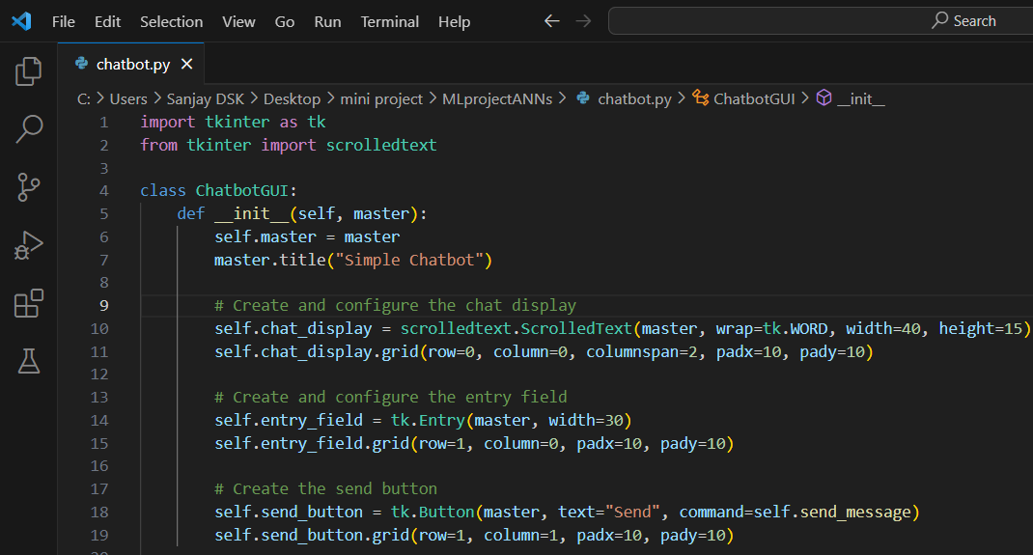
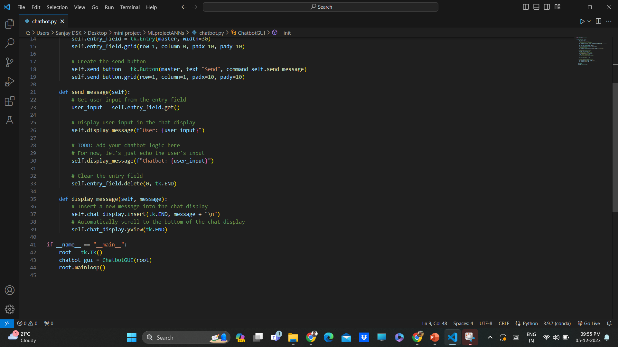
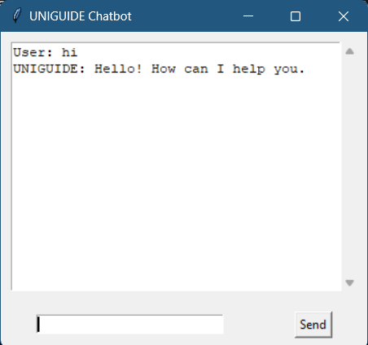
SAMPLE WORK

Slide 8
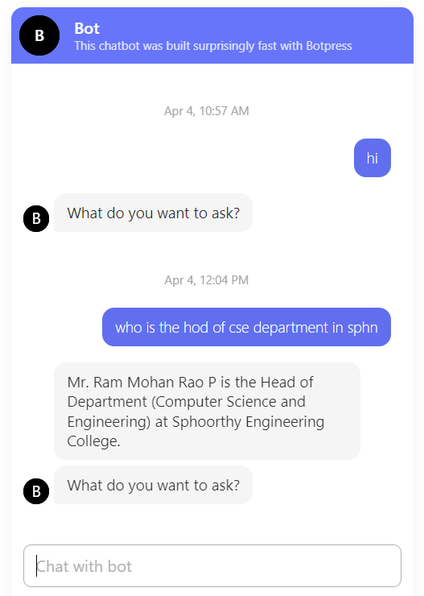
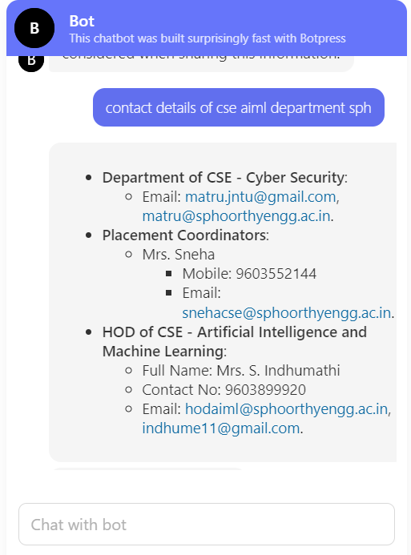
FINAL OUTPUT
Fig.1
Fig.2

Slide 9
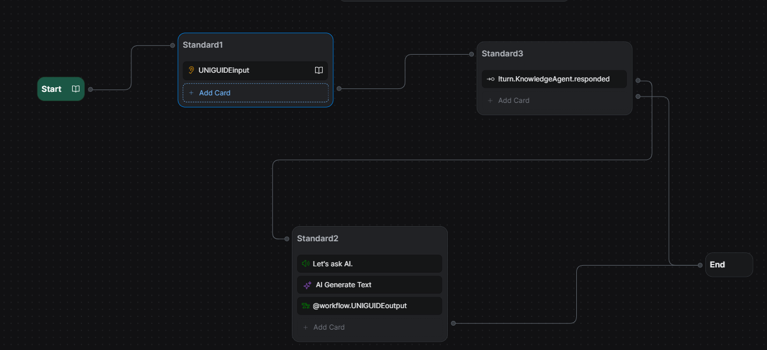
Work Flow

Slide 10
CONFERENCE
THIRTEENTH NATIONAL CONFERENCE ON INNOVATIONS IN INFORMATION TECHNOLOGY(NCIIT `24) CONDUCTED IN BANNARI AMMAN INSTITUTE OF TECHNOLOGY (BIT) ON 22-23 FEB 2024.
PUBLICATION
Publication will be IJEST and Scopus-indexed jounals
International Journal of Innovative Research in Technology

Slide 11
SOFTWARE & HARDWARE REQUIREMENTS
Software Requirements:
Programming Languages:
Python: A widely used language for AI and natural language processing (NLP) tasks.
JavaScript: For building the web-based interface and frontend components.
Web Development:
HTML, CSS, and JavaScript: For creating the user interface and web-based chatbot.
Node.js or Django: For building the backend server that hosts the chatbot.
Database:
MySQL, PostgreSQL, or MongoDB: For storing user data, chat history, and other relevant information.
Hardware Requirements:
Server:
CPU: A multi-core processor to handle concurrent user interactions.
RAM: Sufficient memory to accommodate the application and AI model's requirements.
Storage:
SSD: Faster storage for quicker data access and application responsiveness.
Networking:
Stable and fast internet connection to ensure smooth communication between users and the server.

Slide 12
ALGORITHM
Pattern Matching :
Pattern matching involves identifying predefined patterns or keywords in user input to understand the user's intent. Regular expressions or simple keyword matching can be used for this purpose.
Machine Learning Models :
Decision Trees: For making decisions based on a set of rules.
Support Vector Machines (SVM): For classification tasks.
Naive Bayes: Particularly for text classification.
Recurrent Neural Networks (RNN): For handling sequential data, such as conversational context.
Reinforcement Learning :
Reinforcement learning can be used to allow chatbots to learn from user interactions and improve over time. The chatbot receives feedback in the form of rewards or penalties based on the quality of its responses.

Slide 13
UniGuide Time Plan :
Phase 1:
Planning and Research
Project Initiation
Market Research and Needs Analysis
Technology Selection
Phase 2:
Development and Testing
Bot Design and Architecture
AI Model Training
Bot Development
Testing and Iteration

Slide 14
UniGuide Time Plan :
Phase 3:
Deployment and Launch
Integration and Data Sync
User Acceptance Testing
Phase 4:
Rollout and Maintenance
Launch and Promotion
Monitoring and Optimization
Growth and Expansion

Slide 15
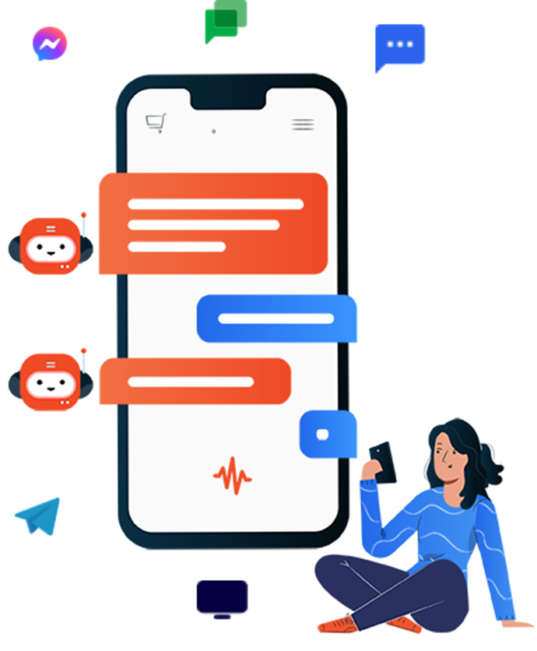
CONCLUSION
UniGuide has the potential to revolutionize the way students navigate university life, providing instant access to information and personalized recommendations tailored to their unique needs.
UniGuide has been designed with students in mind, providing an intuitive and user-friendly chat interface that makes it easy to get the information you need quickly and efficiently.
With UniGuide, students can start making the most of their university experience today, increasing their productivity, improving their performance, and achieving their academic goals.

